Slide 1
Bond investment strategy
Alper YILDIRIM

Slide 2
Contents
Global Market Outlook
Portfolio Distribution
Portfolio Construction
Risk Considerations
Interest Rate Risk
Laddering
Strategy
Inflation Risk
Credit Risk
Inflation Risk
Geopolitical Risk
Global Diversification
CDS/Yield Arbitrage

Slide 3
Portfolio constructıon

Slide 4
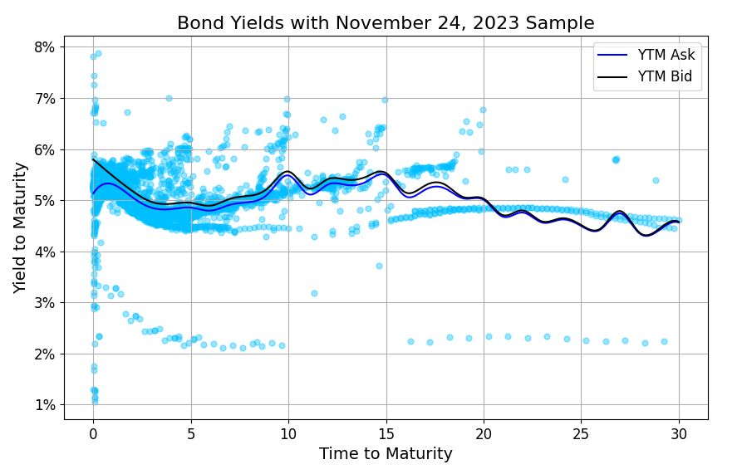
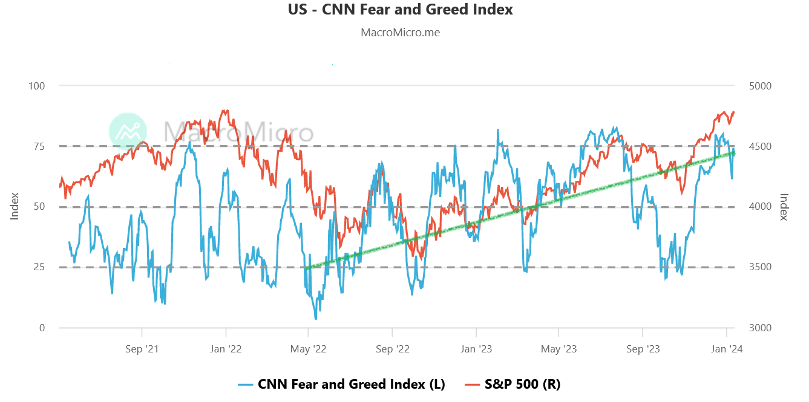
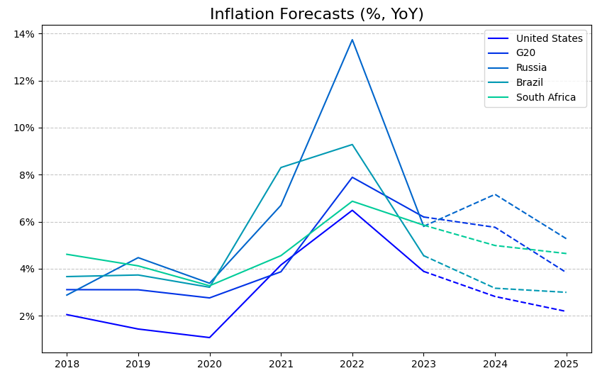
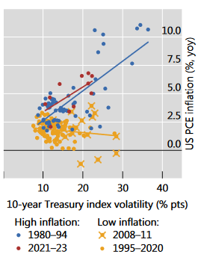
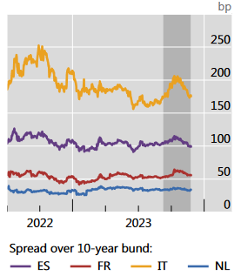
Global market outlook
Inflation ↓ ↔ Investor Sentiment ↑ ↔ Interest Rates ↓
Political agenda: Red Sea conflict, Taiwan elections, Russia-Ukraine War…
Source: CNN Business
Data Source: Bloomberg Terminal Sample
Source: Bank of International Settlements (BIS)
Data Source: OECD Economic Outlook, November 2023

Slide 5
PORTFOLIO DISTRIBUTION
 | YTM | Price | Maturity | Cpn | Rating
Bond 1 |  |  | 1 |  | AAA
Bond 2 |  |  | 1 |  | AA
Bond 3 |  |  | 1 |  | AA
Bond 4 |  |  | 2 |  | BBB
Bond 5 |  |  | 2 |  | AAA
Bond 6 |  |  | 5 |  | AA
Bond 7 |  |  | 10 |  | BBB
Bond 8 |  |  | 30 |  | BBB
Bond Selection Criteria:
Geographical Diversification
Laddering for Risk Aversion
High Cpn Rate
Summary:
60% US Treasuries
Rating Distribution: AAA : 40% BA : 30%
Portfolio Duration:
DV01:

Slide 6
… a more complete pıcture

Slide 7
strategy

Slide 8
Strategy
No “callable” and “putable” bonds
Anticipating interest rate cuts after 2024Q2
“callable”: cheaper re-financing for issuers → increasing reinvestment risk
“putable”: declining rates → less value of put option
Yield curve starts steepening, but not fast → “riding the yield curve” with 2yrs

Slide 9
Strategy
“Key interest rates are likely to fall significantly in 2024. However, this does not necessarily mean that yields will fall and prices on the bond markets will rise.” – Börse Frankfurt (on German bonds)
“The baseline view is for the 2yr to get to 3% and for the 10yr to get to 4%, with the risk of an overshoot to the downside, as a call for 2024. The 30yr likely tracks the 10yr to a point, but is unlikely to get much below 4%, resulting in net 10/30yr steepening, likely targeting 30-50bp.” - Padhraic Garvey, CFA (ING Think)

Slide 10
Comparıson
Bond Fund | YTM | Weighted Price | Weighted Coupon | Avg Credit Rating (surveyed) | Modified Duration | Effective Maturity
JPMorgan Government Bond I | 5.08 | 88.79 | 2.90 | AAA | - | 7.41
iShares Core Total USD Bond ETF | 4.80 | 92.16 | 3.43 | A+ | 6.11 | 8.35
Vanguard Total Bond Market Index | 5.00 | 92.85 | 3.21 | AA | - | 8.70
Schwab Short-Term US Treasury ETF | 5.10 | 96.88 | 2.48 | AA | 1.88 | 1.97
PIMCO Diversified Inc Instl | 7.87 | 87.06 | 4.96 | BBB+ | 5.07 | 8.43
TankX Bond Portfolio Proposal | 5.70 | 95.55 | 3.30 | AA
Data Source: Morningstar

Slide 11
NEGATIVE BASIS TRADES

Slide 12
RISK CONSIDERATIONS

Slide 13
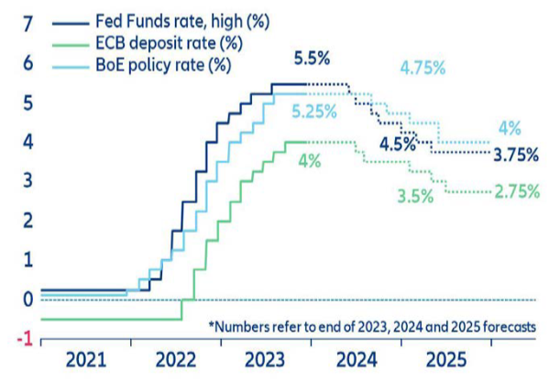
Inflatıon and interest rate rısk
Even though risks persist, inflation started to cool down
Following 2024Q2, interest rate cuts may start
Dollar Duration: Convexity: DV01:
Data Source: OECD Economic Outlook, November 2023
Source: Allianz SE, Global Economic Outlook 2023-25

Slide 14
Lıquıdıty rısk

Slide 15
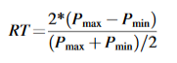
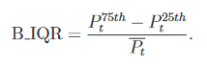
LIQUDITY RISK MEASURES
Given the cross-sectional nature of data, the liquidity proxy is: Bid-Ask Price Difference
If high-frequency time series data is available:
Roundtrip (Feldhütter (2012))
Inter-Quartile Range (Han and Zhou (2007))
Roll (Friewald, Jankowitsch, and Subrahmanyam (2012))

Slide 16
Credıt rısk

Slide 17
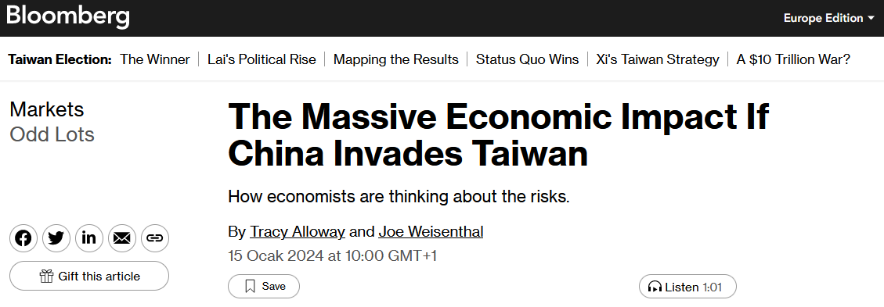
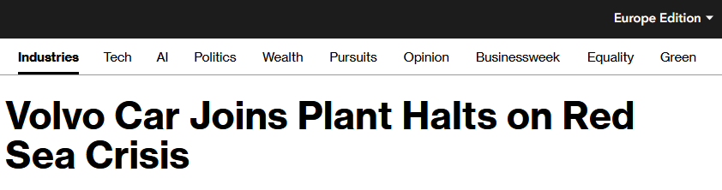
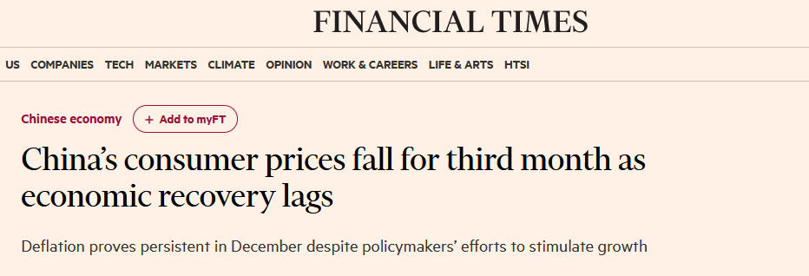
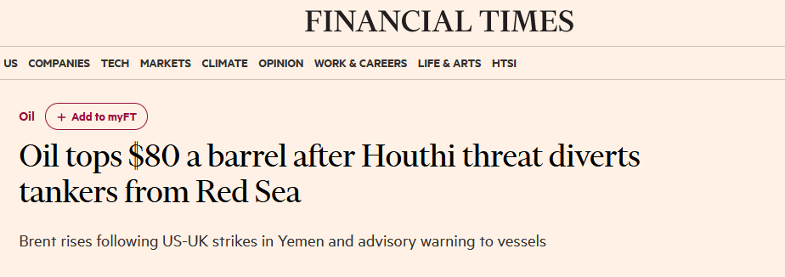
Geopolıtıcal rısk
Avoid Chinese and Middle East Region bonds
Rising political and military tensions may eventually lead economic downturn and declining markets

Slide 18
THANK YOU
Alper Yıldırım
yildirimalper@outlook.de

